Slide 1
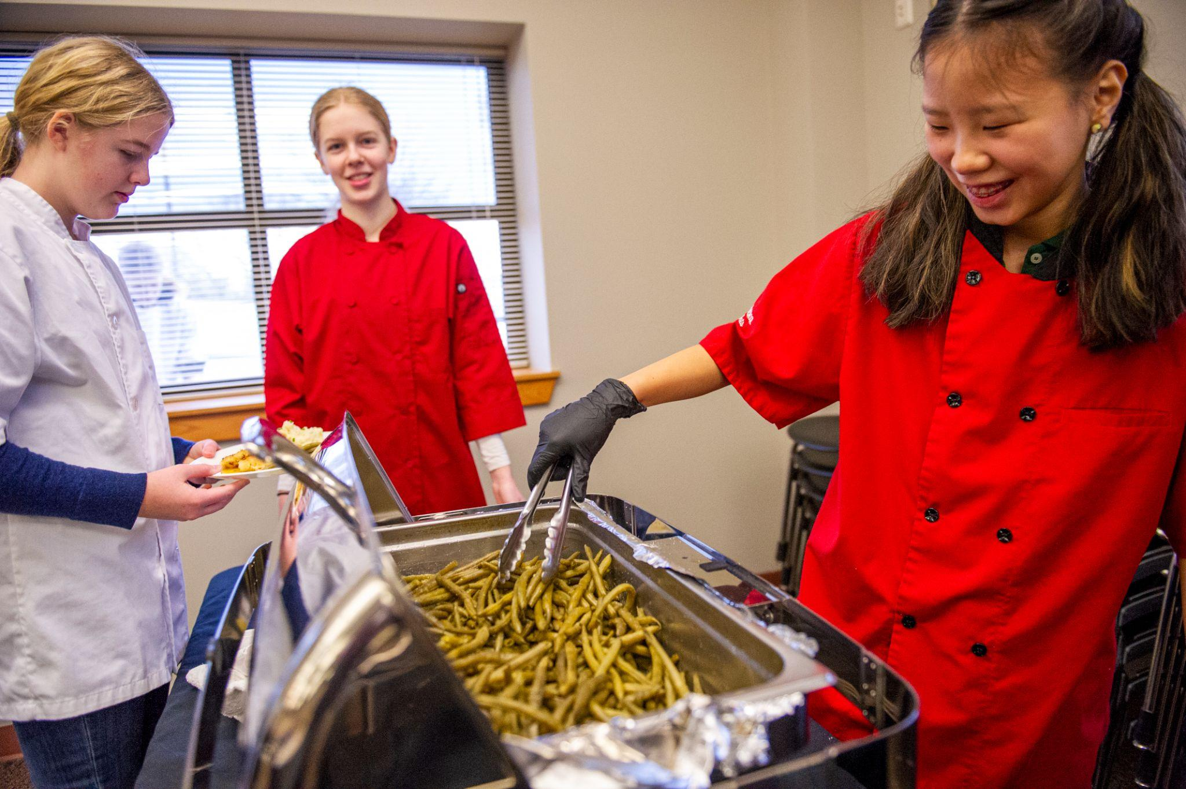
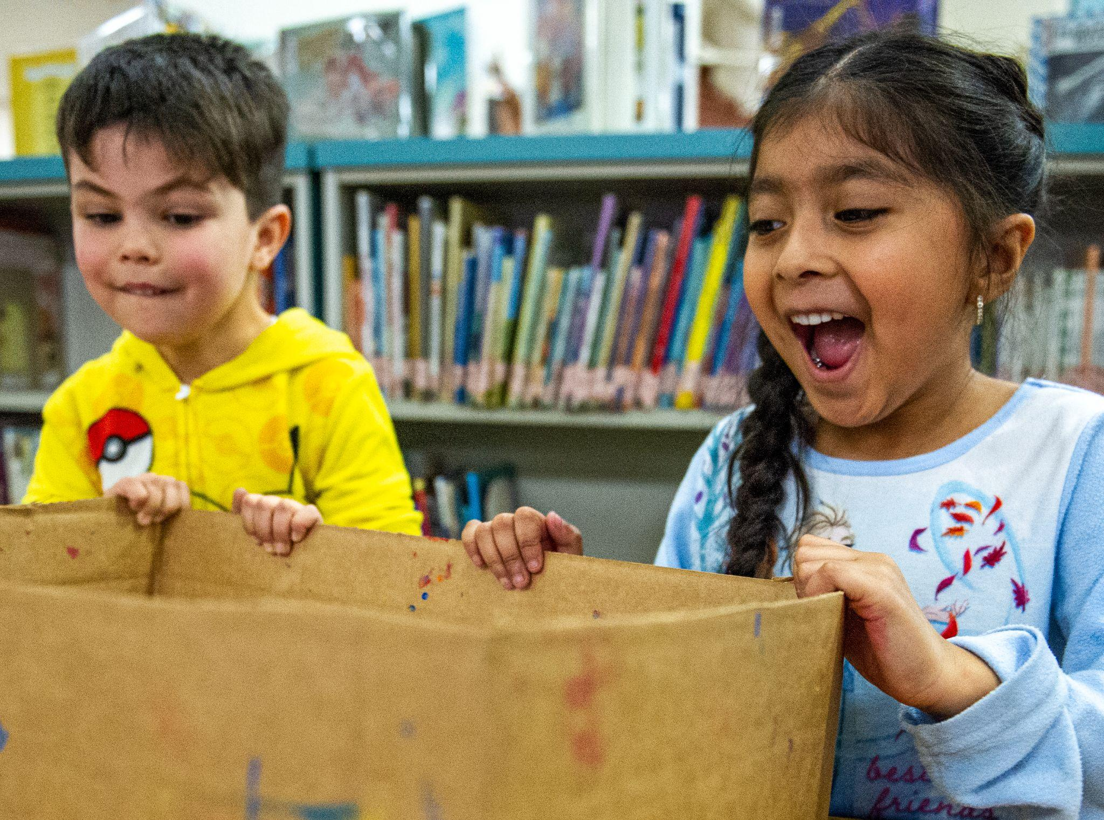
Elger Bay Elementary Board Presentation
April 18, 2023

Slide 2
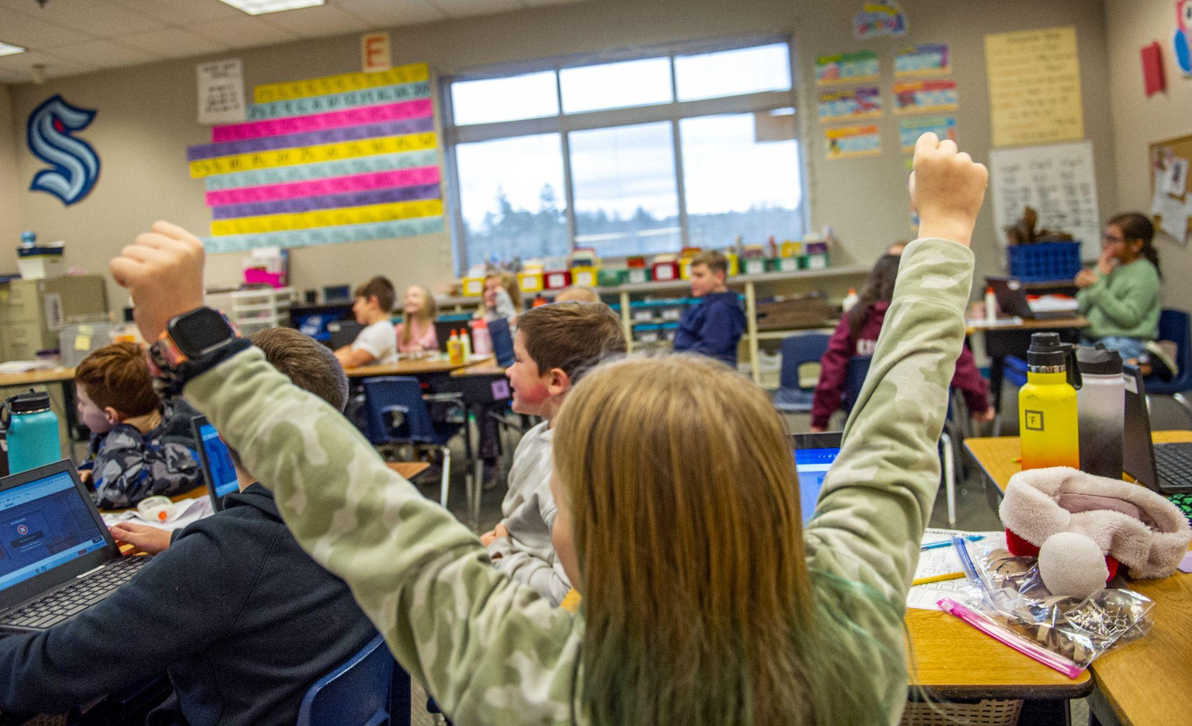
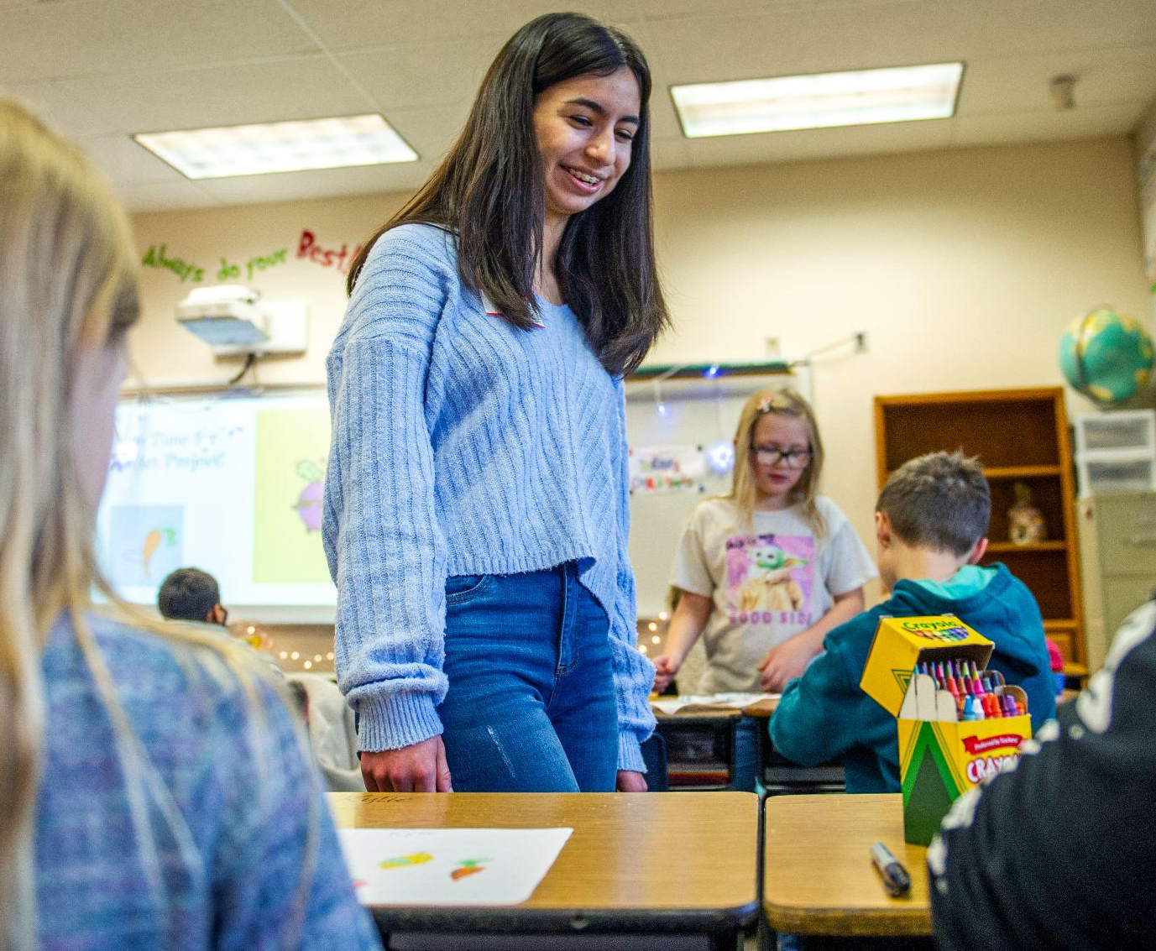
OUR PROMISE
Every student in the Stanwood-Camano School District is empowered to learn in an inclusive setting and is prepared for the future of their choice.

Slide 3
Our AAP Goals (Students will…)
Mathematics
Learn and engage in small group instruction on a consistent basis
Self-reflect on their understanding of standards and use strategies to advocate when needing additional support
English/Language Arts (ELA)
Write daily for a range of tasks, purposes, and audiences within each genre (narrative, informational, and opinion)
Expect and accept productive struggle through the writing process

Slide 4
Our AAP Goals (Students will…)
Multi-Tiered Systems of Support (MTSS) Academic
Articulate the learning targets and success criteria and their progress toward mastery
Consistently demonstrate ownership of learning on formative assessments
Multi-Tiered Systems of Support (MTSS) Behavior
Articulate and demonstrate the expected schoolwide behaviors
Know and explain where to access resources when support is needed
With support, practice strategies for self-regulation as needed

Slide 5
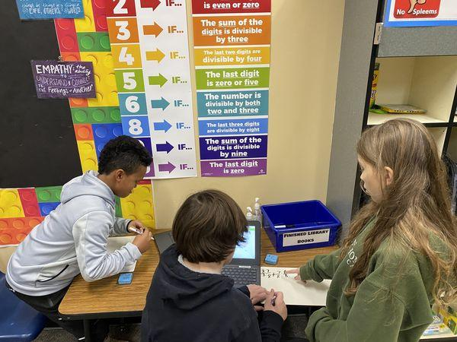
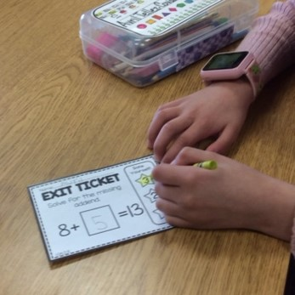
Progress Toward our Goals (Students have…)
Mathematics
Participated in small group individualized instruction
reflected on their progress while completing exit tickets

Slide 6
Progress Toward our Goals (Students have…)
English/Language Arts (ELA)
Write daily for a range of tasks and purposes

Slide 7
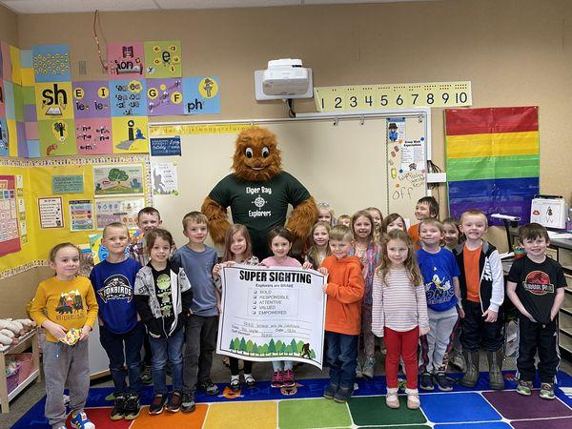
Progress Toward our Goals (Students have…)
Multi-Tiered Systems of Support (MTSS) - Academic and Behavior
Use exit tickets to show their level of understanding towards targets
Demonstrate school wide behavior expectations

Slide 8
Our AAP Strategies and Progress Toward
Math
Staff will:
Teach and develop strategies that students will employ to advocate when needing additional support
Utilize developed exit tickets and gather data to inform small group instruction and allow students to practice self-reflection
Model and practice desired behaviors and tasks for independent or group work while the teacher is working in small groups
Staff have:
Embraced small group instruction for math based on diagnostic assessment data
Participated in professional development related to small group instruction and implemented practices in their classroom

Slide 9
Our AAP Strategies and Progress Toward
ELA (English Language Arts)
Staff will:
Use and apply understanding of the ELA Common Core State Standards when planning and teaching lessons
Develop school wide writing tasks to identify student need and provide opportunities to practice the writing process
Staff have:
Created daily opportunities for students to engage in writing and the writing process

Slide 10
Our AAP Strategies
Multi-Tiered Systems of Supports (MTSS) - Academic and Behavior
Staff will:
Teach and reinforce clear learning targets and success criteria
Us formative assessment and data to identify needed supports for academic intervention
Deliver targeted academic intervention based on student data
Construct PBIS (Positive Behavior Intervention and Supports) schoolwide framework and teach and reinforce expected behaviors with fidelity and consistency
Teach, model and allow opportunities to practice self-regulation strategies
Staff have:
Taught with clear learning targets and success criteria
Used formative assessment to identify students needs
Created the BRAVE system for schoolwide expectations
Taught students how to self-regulate and given the opportunity to practice

Slide 11
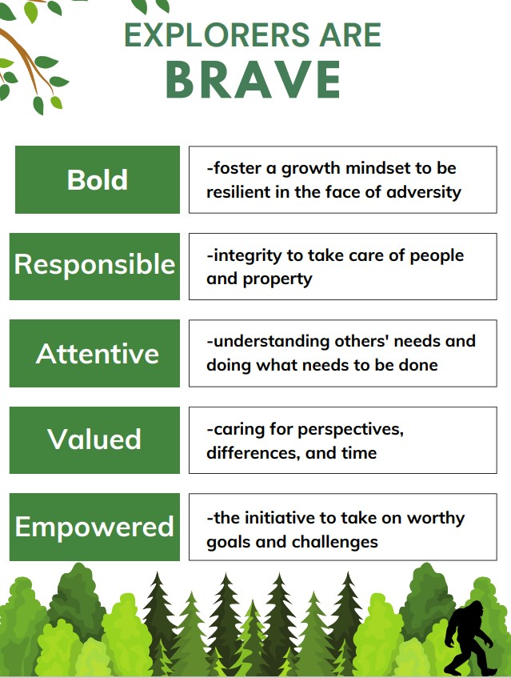
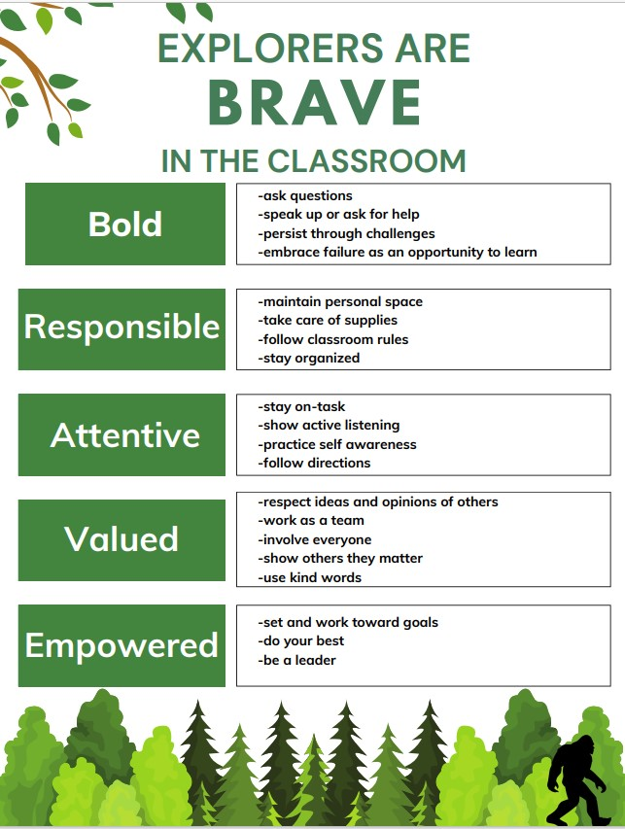
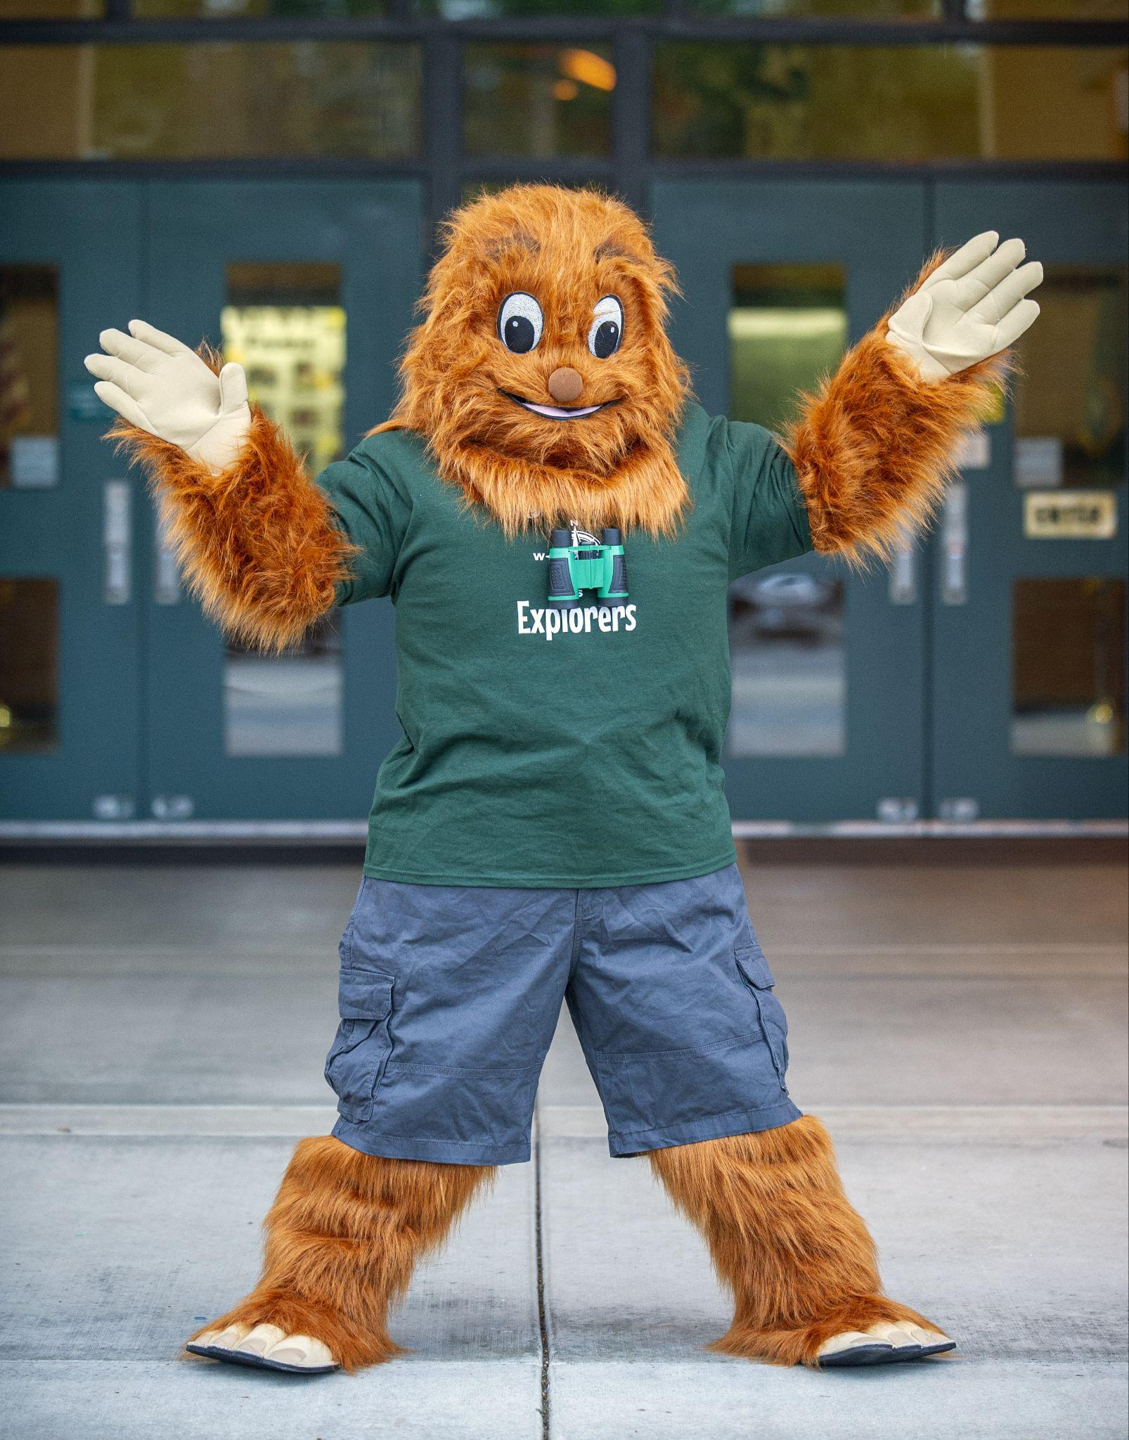
Positive Behavior Intervention and Supports (PBIS)

Slide 12
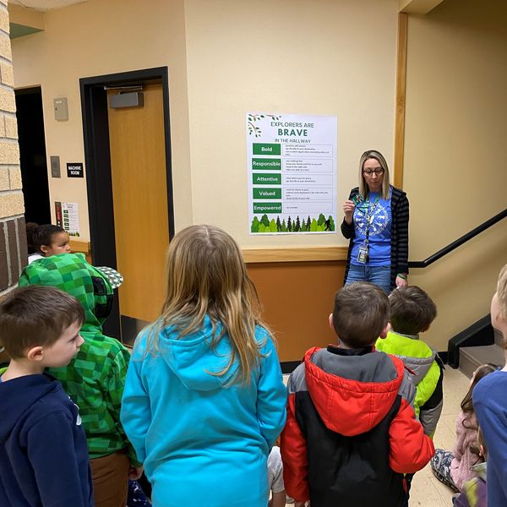
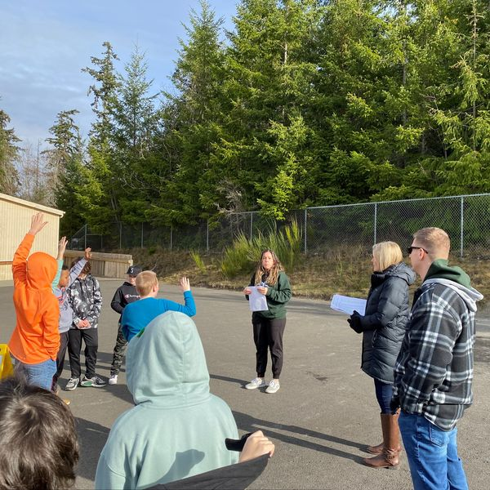

Slide 13
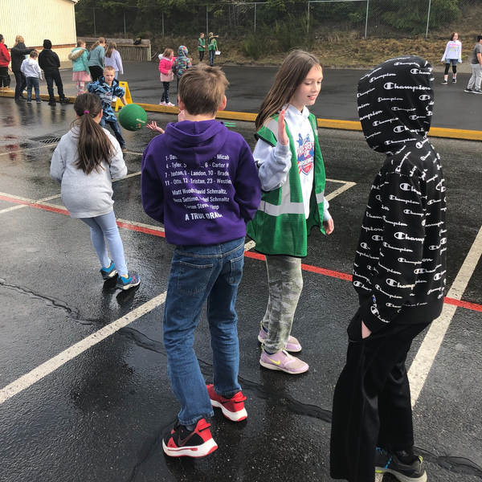
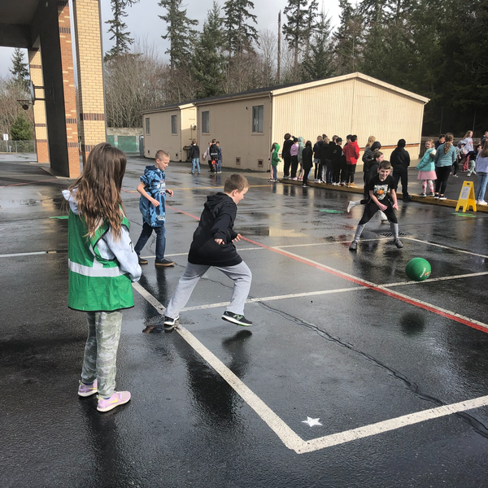
Recess Crew

Slide 14
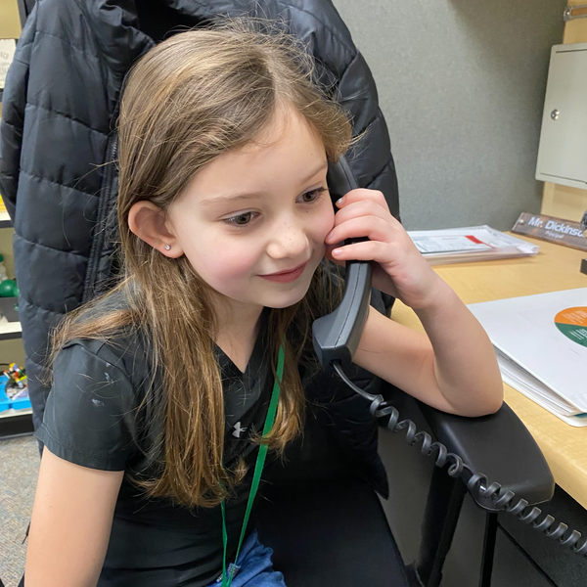
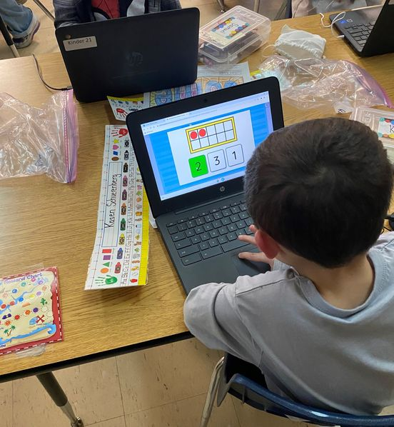
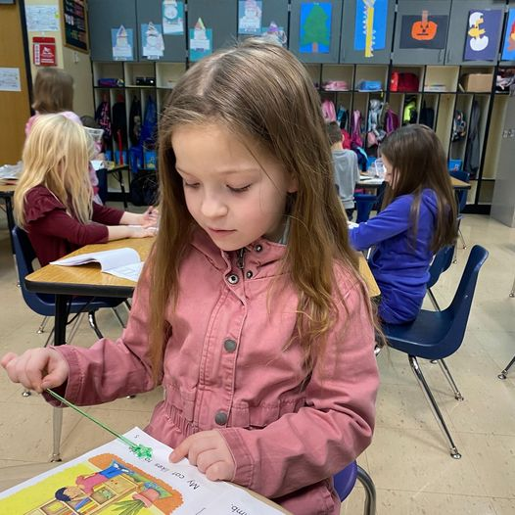
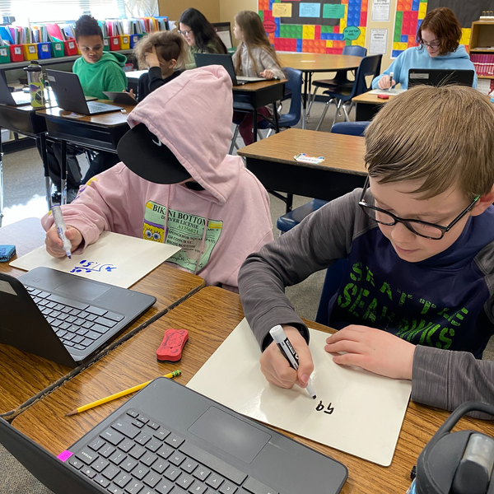
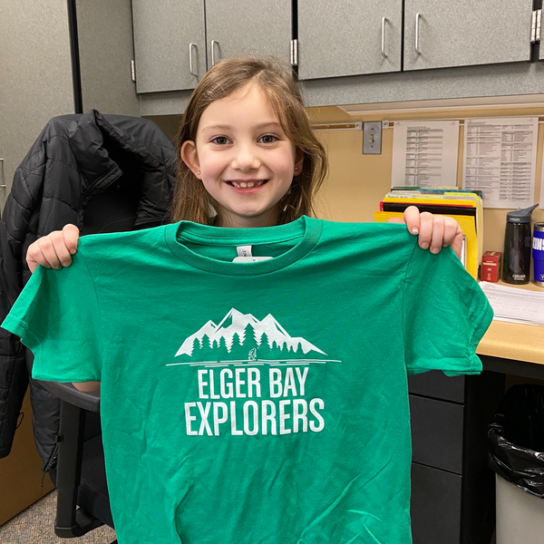

Slide 15
Questions?

Slide 16
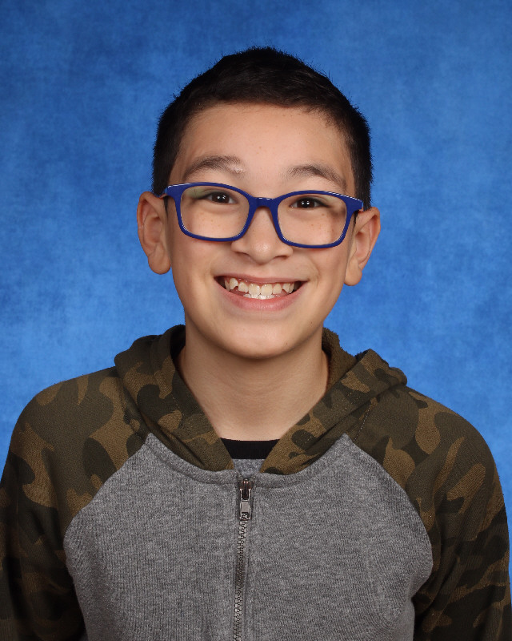
Elger Bay Elementary Shining Star
Elijah Caceres

